Slide 1
Using the Compiler API in Real-World Scenarios
Jason Bock
Practice Lead

Slide 2
Personal Info
http://www.magenic.com
http://www.jasonbock.net
https://www.twitter.com/jasonbock
https://www.github.com/jasonbock
jasonb@magenic.com

Slide 3
Downloads
https://github.com/MarimerLLC/csla
https://github.com/JasonBock/AutoArrange
https://github.com/JasonBock/Rocks
https://github.com/JasonBock/EditorConfigGenerator
https://github.com/JasonBock/Presentations

Slide 4
Overview
Compiler API
Demos
Remember…
https://github.com/MarimerLLC/csla
https://github.com/JasonBock/AutoArrange
https://github.com/JasonBock/Rocks
https://github.com/JasonBock/EditorConfigGenerator
https://github.com/JasonBock/Presentations

Slide 5

Compiler API History
http://www.paperchase.co.uk/content/ebiz/paperchase/invt/00477868/00477868_large.jpg
Notes:
Traditionally, compilers have been black boxes. You don’t have access to their internals.

Slide 6
Compiler API History
csc.exe
YourAssembly.dll
Notes:
This is definitely true of the .NET world. You give the compiler a bunch of code files and other assets, and the compiler magically turns that into a file that contains executable code.

Slide 7
Compiler API History
csc.exe
YourAssembly.dll
44 switches
http://msdn.microsoft.com/en-us/library/6ds95cz0.aspx
Notes:
You have very little control over the current .NET compiler. You can pass in some switches, but they’re not very interactive.

Slide 8
Compiler API History
Resharper
SharpDevelop
NCover
NDepend
CodeRush
Notes:
This is sad, because the compiler generates a lot of useful information about your code. Other tools have to, in a sense, create their own compilers to provide their great functionality. They’re forced to duplicate what’s already been done. But what happens if they don’t do the exact same thing that the MS compiler does?

Slide 9
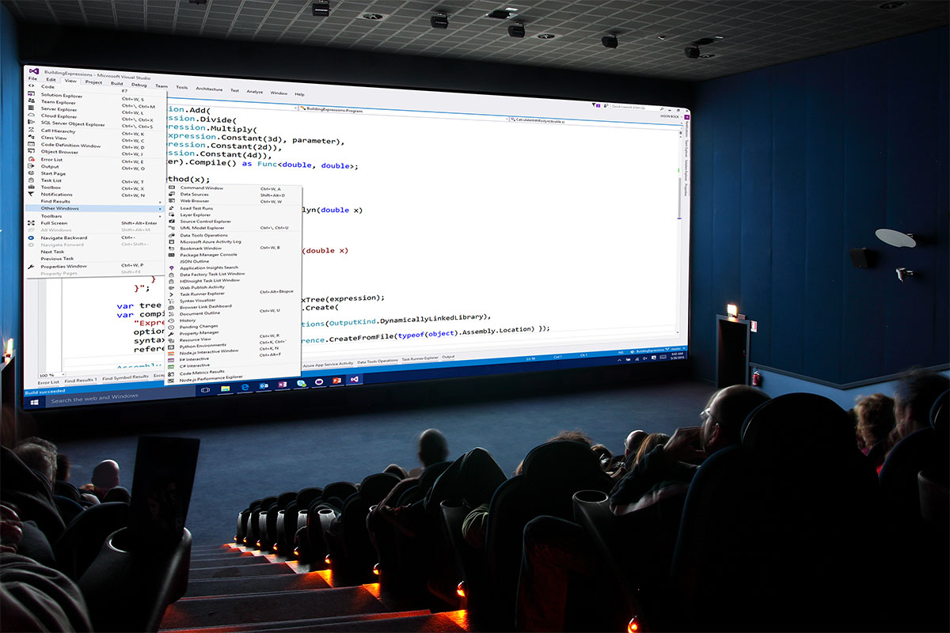
Compiler API History
Notes:
Also, this has limited MS in terms of the features they can add to C# and their toolchain.

Slide 10

Compiler API History
http://www.springlakeranch.ca/images/_aug09/whitebox.jpg
Notes:
Let’s open up the compiler and provide that information and functionality to every developer.

Slide 11
Compiler API History
csc.exe
YourAssembly.dll
Parsing
Symbols
Binding
Emitting
Notes:
All the parsing, emitting. Etc logic should be available to other tools to do all sorts of crazy, interesting stuff.

Slide 12


Compiler API History
https://github.com/dotnet/swag/blob/master/roslyn/roslyn_kuhlenh.png
https://github.com/dotnet/swag/blob/master/roslyn/roslyn_icon_kuhlenh.png
Notes:
That’s what Project Roslyn, or the Compiler API, is all about.

Slide 13
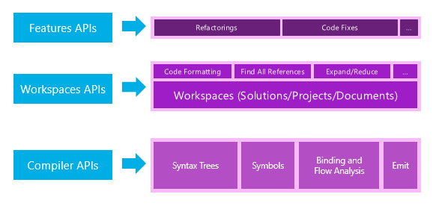
Compiler API History
http://msdn.microsoft.com/en-US/roslyn
Notes:
That’s the intent of Project Roslyn: to provide all of that to you as a .NET API.

Slide 14
Demo: Compiler API Usage
Using the Compiler API in Real-World Scenarios
Notes:
We’ll look at three usages:
Analyzers: CSLA
Refactoring: AutoArrange
Code Generation: Rocks and EditorConfigGenerator

Slide 15
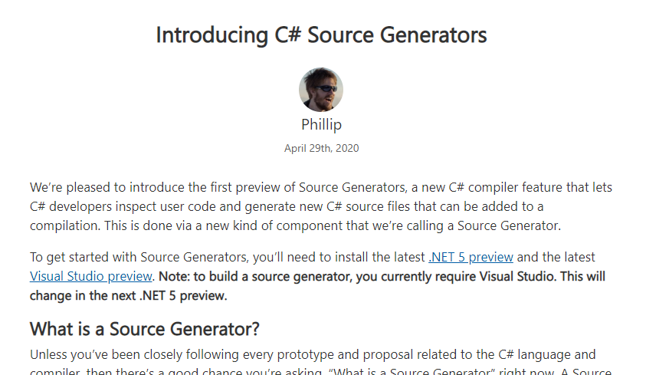
Source Generators
https://devblogs.microsoft.com/dotnet/introducing-c-source-generators/
Notes:
This is (probably) coming in C#9. Dive in!

Slide 16
Using the Compiler API in Real-World Scenarios
Remember…
https://github.com/MarimerLLC/csla
https://github.com/JasonBock/AutoArrange
https://github.com/JasonBock/Rocks
https://github.com/JasonBock/EditorConfigGenerator
https://github.com/JasonBock/Presentations
References in the notes on this slide
Jason Bock
Practice Lead
Notes:
References
Code
.NET Compiler Platform ("Roslyn") - https://github.com/dotnet/roslyn
.NET Compiler Platform ("Roslyn") Analyzers - https://github.com/dotnet/roslyn-analyzers
Source Generators
Introducing C# Source Generators - https://devblogs.microsoft.com/dotnet/introducing-c-source-generators/
Source Generators Samples - https://github.com/dotnet/roslyn-sdk/tree/master/samples/CSharp/SourceGenerators
INotifyPropertyChanged with C# 9.0 Source Generators - https://jaylee.org/archive/2020/04/29/notify-property-changed-with-rosyln-generators.html
C# Source Generators: Less Boilerplate Code, More Productivity - https://dontcodetired.com/blog/post/C-Source-Generators-Less-Boilerplate-Code-More-Productivity
Articles
Adding a Code Fix to Your Roslyn Analyzer - https://msdn.microsoft.com/en-gb/magazine/dn904670.aspx
Analyzing Control Flow with Roslyn - http://www.wintellect.com/devcenter/jrobbins/analyzing-control-flow-with-roslyn
Automated code quality testing using Roslyn - http://www.novanet.no/blog/claus-asbjorn-sorensen/dates/2013/2/automated-code-quality-testing-using-roslyn/
Building Visual Studio Extensions with Roslyn - http://www.infoq.com/news/2011/10/Rosyln-Extensions
C# compiler improvements - https://improvecscompiler.codeplex.com/documentation
Community Involvement and Roslyn - http://thebillwagner.com/blog/community-involvement-and-roslyn
Compile C# Expressions Without Using the Scripting API - http://mhusseini.wordpress.com/2014/05/23/roslyn-compile-c-expressions-without-using-the-scripting-api/
Going Deeper with Project Roslyn: Exposing the C# and VB compiler’s code analysis - http://channel9.msdn.com/Events/Lang-NEXT/Lang-NEXT-2012/Roslyn
How Microsoft’s Next-Gen Compiler Project Can Improve Your Code - http://msdn.microsoft.com/en-us/magazine/dn296510.aspx
In bed with Roslyn - http://www.mindscapehq.com/blog/index.php/2011/10/20/in-bed-with-roslyn/
Implementing a Code Action using Roslyn - http://blogs.msdn.com/b/csharpfaq/archive/2012/02/06/implementing-a-code-action-using-roslyn.aspx
Interface implementation delegation - http://msmvps.com/blogs/matthieu/archive/2014/02/26/interface-implementation-delegation.aspx
Lap Around Roslyn CTP
Introduction - http://blogs.microsoft.co.il/blogs/sasha/archive/2011/10/21/lap-around-roslyn-ctp-introduction.aspx
Syntax Rewriting - http://blogs.microsoft.co.il/blogs/sasha/archive/2011/10/23/lap-around-roslyn-ctp-syntax-rewriting.aspx
Syntax Rewriting with Symbol Information - http://blogs.microsoft.co.il/blogs/sasha/archive/2011/10/25/lap-around-roslyn-ctp-syntax-rewriting-with-symbol-information.aspx
Syntax Analysis and Flow Analysis - http://blogs.microsoft.co.il/sasha/2011/10/27/lap-around-roslyn-ctp-syntax-analysis-and-flow-analysis/
Learn Roslyn Now - https://joshvarty.wordpress.com/learn-roslyn-now/
LRN Quick Tips: Don’t trust SyntaxNode.ToFullString() - https://joshvarty.wordpress.com/2015/03/30/lrn-quick-tips-dont-trust-syntaxnode-tofullstring/
Modifying Code With Project Roslyn - http://magenic.com/Blog/ModifyingCodewithProjectRoslyn.aspx
Microsoft “Roslyn” CTP - http://msdn.microsoft.com/en-us/roslyn
More Wintellect.Analyzers and Some Lessons Learned Writing Roslyn Analyzers - http://www.wintellect.com/devcenter/jrobbins/more-wintellect-analyzers-and-some-lessons-learned-writing-roslyn-analyzers
MSR Faculty Summit 2011: Refactoring with Roslyn - http://research.microsoft.com/apps/video/?id=152281
MvvmCross as a Code-Aware Library with Roslyn Code Analyzers
Part 1 - http://stephanvs.com/mvvmcross-as-a-code-aware-library-through-code-analyzers/
Part 2 - http://stephanvs.com/mvvmcross-as-a-code-aware-library-with-roslyn-code-analyzers-part-2/
Query Methods in Roslyn Syntax API - http://debugmode.net/2011/10/25/query-methods-in-roslyn-syntax-api/
Replacing a Class at Runtime Using Ninject and Roslyn
Part 1: The Goal - http://blog.zerosharp.com/replacing-a-class-at-runtime-using-ninject-and-roslyn-part-1/
Part 2: The Solution - http://blog.zerosharp.com/replacing-a-class-at-runtime-using-ninject-and-roslyn-part-2/
Part 3: Dependency Injection - http://blog.zerosharp.com/replacing-a-class-at-runtime-using-ninject-and-roslyn-part-3/
Part 4: Roslyn - http://blog.zerosharp.com/replacing-a-class-at-runtime-using-ninject-and-roslyn-part-4/
Rise of Roslyn, Part 2: Writing Diagnostics - https://msdn.microsoft.com/en-gb/magazine/dn904676.aspx
The Roslyn Preview Is Now Available - http://blogs.msdn.com/b/ericlippert/archive/2011/10/19/the-roslyn-preview-is-now-available.aspx
Roslyn Project Overview Document - http://go.microsoft.com/fwlink/?LinkID=230702
Roslyn Syntax Visualizers - http://blogs.msdn.com/b/visualstudio/archive/2011/10/19/roslyn-syntax-visualizers.aspx
scriptcs - http://scriptcs.net/
scriptcs – Living on the edge in C# without a project on the wings of Roslyn and Nuget - http://codebetter.com/glennblock/2013/02/28/scriptcs-living-on-the-edge-in-c-without-a-project-on-the-wings-of-roslyn-and-nuget/?utm_source=feedburner&utm_medium=feed&utm_campaign=Feed%3A+CodeBetter+%28CodeBetter.Com%29
Scripting and Code Analysis using Roslyn – And a first look at Roslyn CTP - http://www.amazedsaint.com/2011/10/c-vnext-roslynan-introduction-and-quick.html
Unit Testing Roslyn-Based Extensions - http://magenic.com/Blog/PostId/20/unit-testing-roslyn-based-extensions

